Slide 1
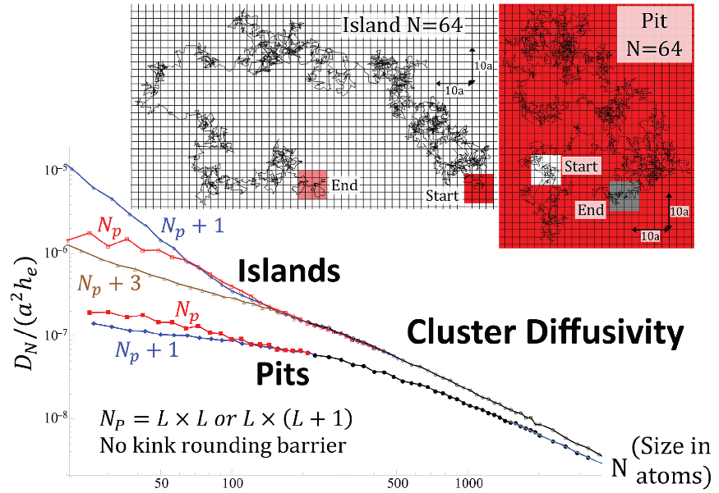
Stochastic particle-level modeling of nanocluster formation and coarsening on surfaces: Cluster diffusion & coalescence
Jim Evans, Alex Lai, Da-Jiang Liu, Yong Han (theory), Patricia Thiel (expt.)
Dept. of Physics & Astronomy and Dept. of Mathematics, Iowa State University
Ames Laboratory – USDOE, Iowa State University
Funding: NSF grant CHE-1507223
KC Lai, D-J Liu, PA Thiel, JW Evans
J. Phys. Chem. C 122 (2018) 11334

Slide 2
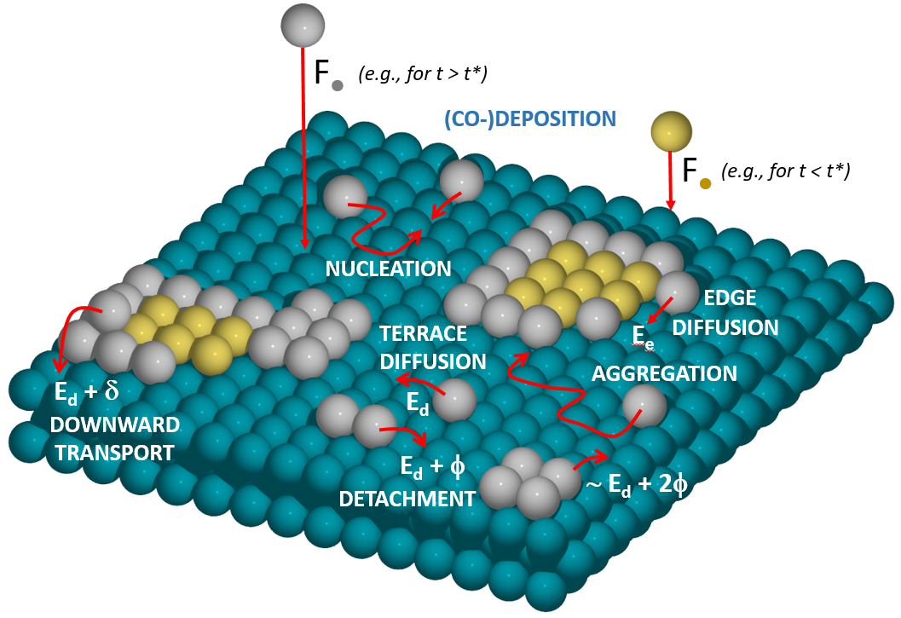
Stochastic lattice-gas model for nanocluster formation during deposition
Deposition & various surface
diffusion processes involving
hopping to adjacent adsorption
sites forming a periodic lattice
occur stochastically with prescribed
rates (i.e., as Markovian Processes
with appropriate exponential
waiting time distributions)
Surface hopping rates:
h_{α} = ν exp[-E_{act}/(k_{B}T)]
where E_{act} depends on
local environment α
Lai et al. Chem. Rev. (2019) subm.
Evans et al. Surf. Sci. Rep. 61 (2006) 1
♦ Analytic theory: rate equations; BCF deposition-diffusion equns; LSW & Smoluchowski equn (coarsening)
♦ KMC simulation where processes are implemented stochastically with probabilities proportional to rates

Slide 3
OUTLINE
This talk will focus on two-dimensional systems:
single-atom high (2D) metal islands or nanoclusters (NCs) on flat metal surfaces
Formation, i.e., self-assembly, of NCs during deposition
(i.e., diffusion-mediated NC nucleation and subsequent growth by aggregation)
Q1. Size and spatial distribution for ensembles or arrays of NCs
Q2. Far-from-equilibrium growth structure of individual NCs
Post-deposition coarsening of NC ensembles/arrays via
Ostwald Ripening or Smoluchowski Ripening (NC diffusion & coalescence)
Q1. Ensemble-level evolution of NC size distribution (LSW, etc.)
Q2. Dynamics of individual NCs ( growth/decay in Ostwald Ripening;
⇒ ⇒ ⇒ ⇒ ⇒ ⇒ ⇒ diffusion and coalescence in Smoluchowski Ripening )
For surface systems, clear separation of time scales between NC formation and NC coarsening.

Slide 4
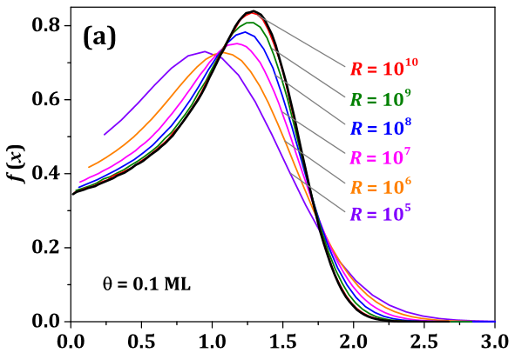
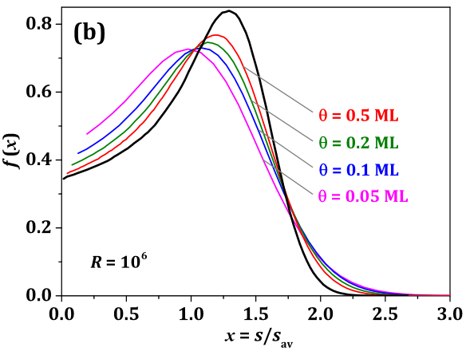
RATE EQUN ANALYSIS OF ISLAND/NC SIZE DISTRIBUTION
Rate Equation Formulation …mean-field (MF) versions by Zinsmeister, Venables,… from 1960’s
N_{s} = density of stable islands of size s > i (critical size); N_{isl} = ∑_{s>i} N_{s} = total density; N₁ = adatom density
d/dt N_{s} = σ_{s-1} h N₁ N_{s-1} - σ_{s} h N₁ N_{s} where σ_{s} = avg. capture number for s > i
gain loss …h = terrace atom hop rate
h
s-1
h
s
Scaling for large h/F ⇒ large s_{av} ~ (h/F)^{i/(i+2)} θ^{z} with z=(i+1)/(i+2) ⇒ N_{s} ∝ f(x = s/s_{av}); σ_{s} ∝ c(x = s/s_{av})
⇒ f(x) = f(0) exp[ ∫_{0<y<x} dy ]
(2z-1) - c′(y)
c(y) – z y
Bartelt and Evans PRB 54 (1996) 17352
Evans et al. Surf. Sci. Rep. 61 (2006) 1-128
Approach to scaling limit
…depends on θ/θ* where
θ* ~ (h/F)^{-2/(i+3)} denotes
end of transient regime &
start of steady-state regime
Han, Gaudry, Oliveira, Evans
J Chem Phys 145 (2016) 211904
KMC
i = 1

Slide 5
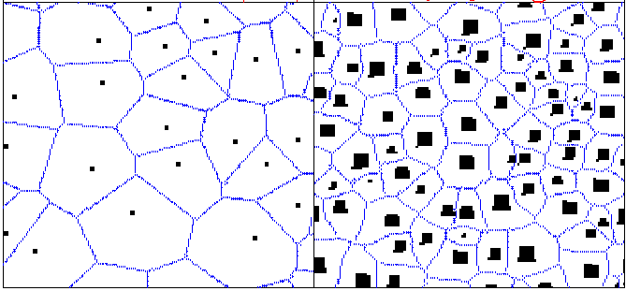
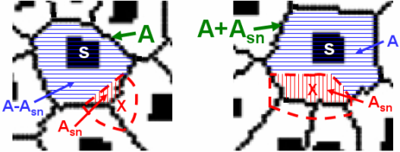
CAPTURE-ZONE AREA DISTRIBUTIONS: THEORY
Surface is tessellated into capture
zones (CZs) where islands grow by
capture of (most) atoms deposited
in their CZ ⇒ island growth rate
∝ CZ area ∝ capture number.
Nucleation occurs predominantly
nearby CZ boundaries away from
islands (higher adatom density)
θ=Ft
<<1
θ=Ft
≈ 0.1 ML
Develop fundamental rate equation theory for population, N_{A}, of CZs
of area A which must account for subtle spatial aspects of nucleation
d
A
N_{A} = - + +
dt
X
Probability Q(A) to overlap Probability P_{nuc}(A) to nucleate
existing CZ of area A ? new island with CZ area A ?
Han, Li, Evans, J. Chem. Phys. 145 (2016) 211911; Li, Han, Evans, PRL 104 (2010) 149601.

Slide 6
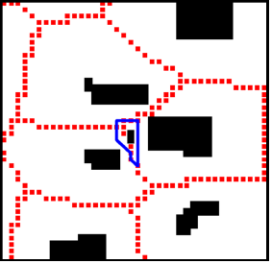
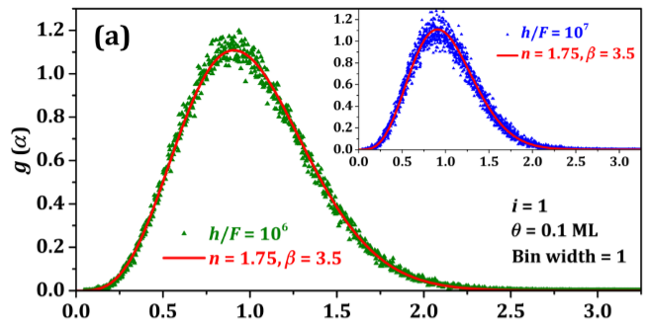
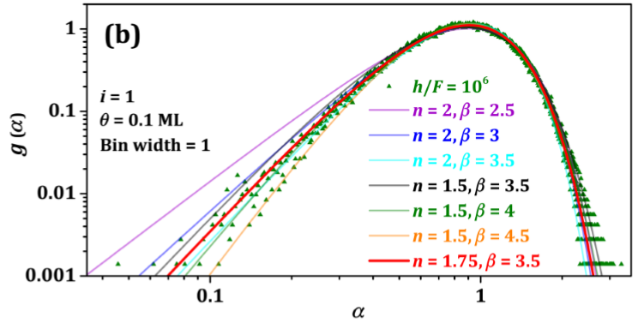
SCALING FORM N_{A} ∝ g(α = A/A_{av}) : THEORY, KMC
SMALL CZ AREAS: g(α) ∼ α^{β} controlled by probability
P_{nuc}(A) to create small CZ involves island nucleation
in the center of a group of existing nearby islands.
Han, Li and Evans PRL10, JCP16: β = 3 (i=0), 4.5 (i=1)
cf. Pimpinelli + Einstein PRL07,10: β = 2 (i=0), 3 (i=1)
versus KMC: β = 2.75-3 (i=0), 3.5-4 (i=1)
LARGE CZ AREAS: g(α) ∼ exp(-bα^{n}) …with α << 1
Han, Li and Evans: …controlled by large Q(A) for large A ? n = 1.5 ? (i=1)
cf. Pimpinelli + Einstein: Gaussian tail n = 2 (heuristic FPE) …vs KMC n =2 ?
log-log plot
i = 1
i = 1

Slide 7
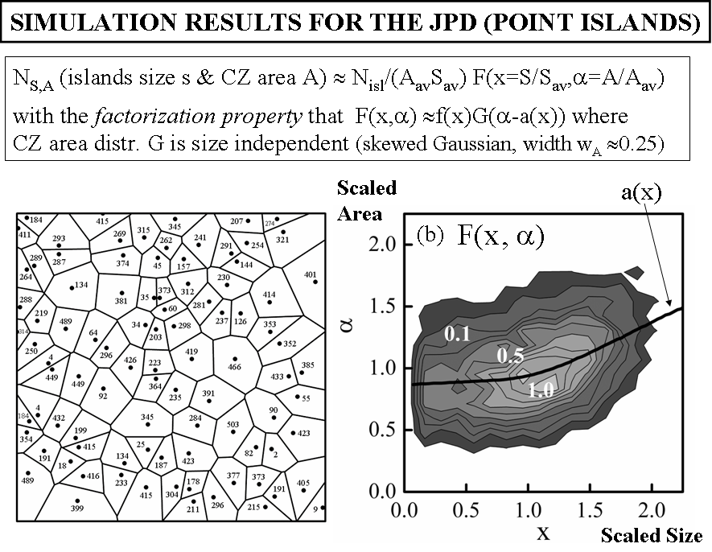
JOINT PROBABILITY DISTRIBUTION (JPD): POINT ISLAND RESULTS
= c(x)
Mulheran & Robbie EPL 49 (2000) 617; Bartelt + JE PRB 66 (2002) 235410

Slide 8
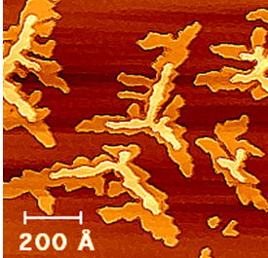
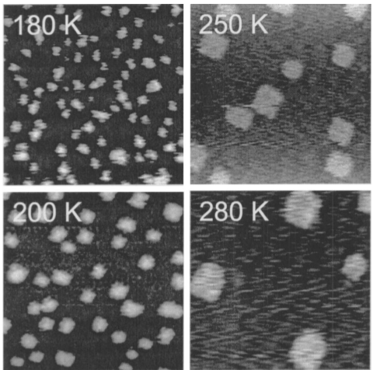
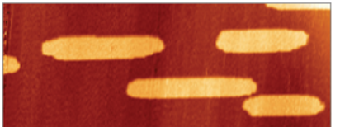
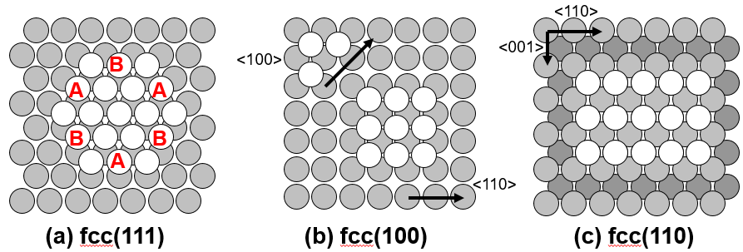
Non-equilibrium growth shapes of NCs
Ag/Ag(111) Ag/Ag(100) Ag/Ag(110)
135 K
194 K 80 x 30 nm²
25 x 25 nm²
220 K 120 x 90 nm²
Eq.
Eq.
Equil.
aspect ratio 3
Cox et al. (ISU) PRB 71 (2005) Frank et al. (Ulm + ISU) PRB 66 (2002) Han et al. (ISU) PRB 88 (2013), PRB 87 (2013)

Slide 9
HOPPING BARRIER SELECTION: GENERAL AB-INITIO LEVEL TREATMENT
JPCC 120 (2016) 28639; JPCL 6 (2015) 2194; NL 14 (2014) 4646; PRL 108 (2012) 216102; PNAS 108 (2011); PRB 84 (2011); JCP 135 (2011)
h = ν exp(-E_{act}/kT)
transition
state (TS)
E_{TS}
E_{init}
thermally activated hop
final
state
E_{act} = E_{TS} - E_{initial}
initial
state
Initial State
Conventional
interactions
Transition state
Unconventional
interactions
Key ingredient: Determine unconventional adatom interactions ε_{int}(TS-ad) with one atom
at TS as well as conventional interactions ε_{int}(initial-ad) with both atoms at adsorption sites.

Slide 10
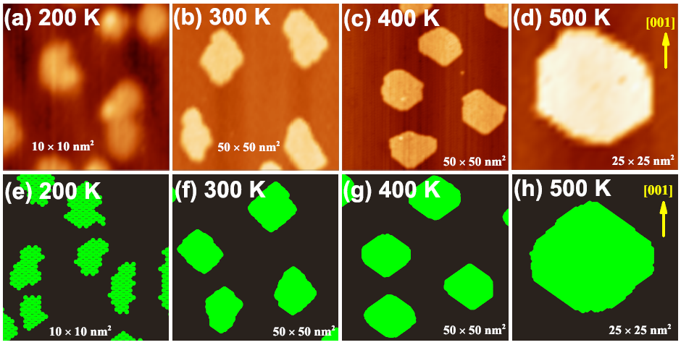
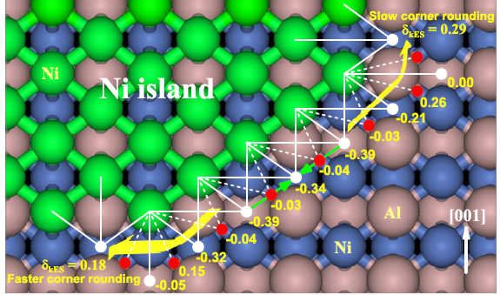
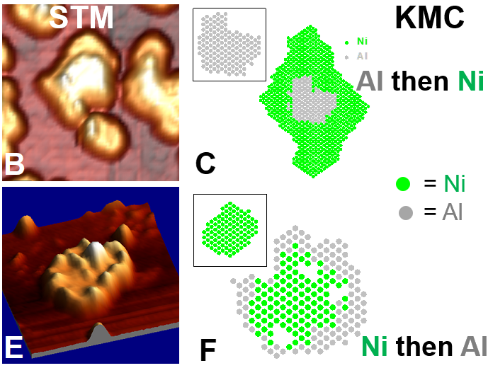
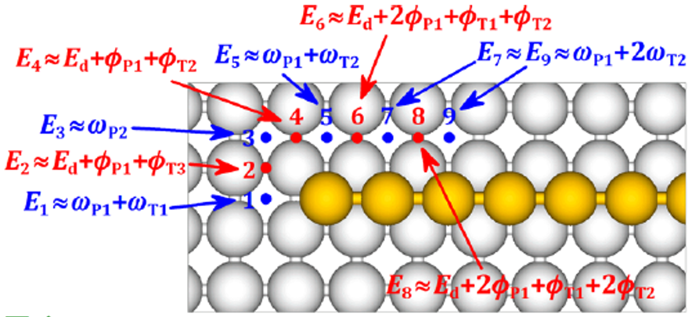
Ni on NiAl(110) @ 300-500 K
STM
KMC
Han et al. J Chem Phys 135 (2011) 084706
Ni + Al co-deposition on NiAl(110)
Au (+ Ag) on Ag(100)
250 K
300 K
Han et al. PRL (2012) 216102 Duguet et al. PNAS 109 (2011) 989
Han et al. JPCL 6 (2015) 2194; Nano Lett. 14 (2014) 4646

Slide 11
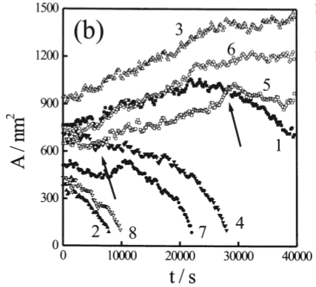
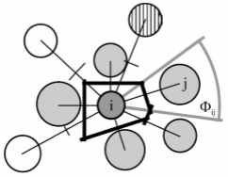
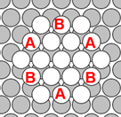
Coarsening of 2D NC ensembles in fcc homoepitaxy
Reviews: Thiel, Shen, Liu, Evans J. Phys. Chem. C 113 (2009) 5047; Karina Morgenstern Phys. Stat. Sol. B 242 (2005) 773
Ostwald Ripening (OR) of 2D Ag islands on Ag(111) surfaces
166 min
332 min
300 K
300 K
Diffusion-limited OR
BASIC FEATURES OF OR:
Equilibrated island shapes ⇒ well-defined chemical potential μ(R) = μ(∞) + γ/R
Gibbs-Thompson: adatom density equil. with island ρ_{eq}(R) ≈ ρ_{eq}(∞)[ 1 + γ/(k_{B}T R)]
Diffusive mass flow from higher μ & ρ_{eq} to μ & ρ_{eq} lower via ∂ρ/∂t = D∇²ρ(x) ≈ 0
Chernov Boundary Condition (BC) at island edges involves a kinetic coefficient K
Kinetic coefft K describes ease of attachment of diffusing atoms to island edges
For metal islands typically no attachment barrier ⇒ K = ∞ ⇒ Dirichlet BC ρ = ρ_{eq}
R = island “radius”

Slide 12
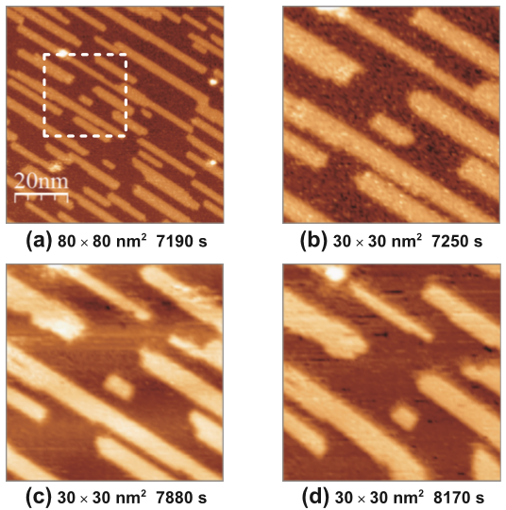
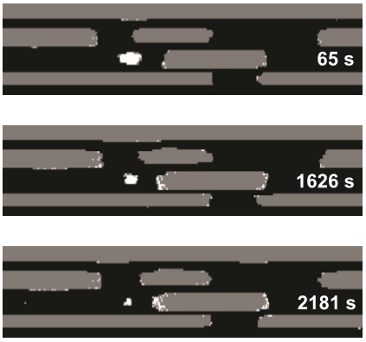
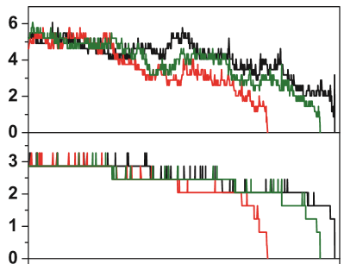
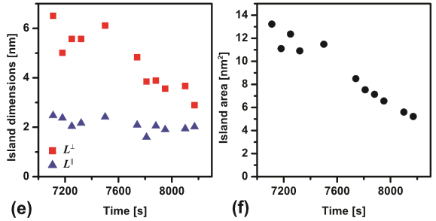
STM
Ostwald Ripening (OR) of 2D Ag
islands in Ag(110) for T < 220K
190 K
Han, Russell,… Thiel, Evans PRB 87, 155420 (2013)
Wang, Han, Walen,… Thiel, Evans PRB 88, 155434 (2013)
Initial study: Morgenstern et al. PRL 83 (1999) 1613
KMC @190 K
nm
length
length
width
width
area
KMC with realistic
atomistic-level
Ag/Ag(110) model
Lack of island shape equilibration ⇒ introduce partial chem. potentials for length vs width change
Refined kinetic coefficients: K < ∞ even if no energy barrier for attachment to step edges
which have few kinks (since incorporation of diffusion atoms into islands occurs at kinks)
Derivation: Coarse-graining of 2D discrete diffusion equn incorporating kinked steps
Ackerman & Evans SIAM MMS 9 (2011) 59; Zhao, Ackerman, JE PRB 91 (2015) 235411; Zhao, JE, Oliveira PRB 93 (2016) 165411 – step permeability

Slide 13
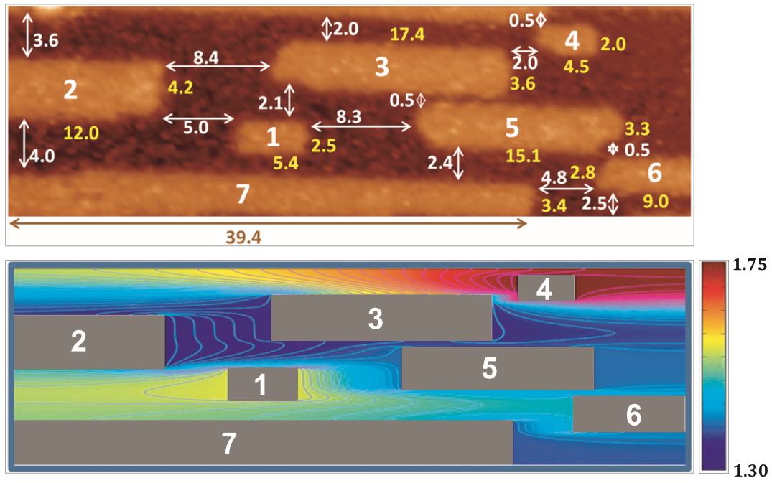
Continuum diffusion equn BVP analysis for rates of growth/decay of islands
n
Narrower islands with higher partial chem. potentials shrink and transfer atoms to wider islands.
Focusing on “narrow” island 1: initial rate of decay from analysis of BVP: R1 = -0.0022 nm²/s
Experimental decay rate R1 ∼ -0.005 nm²/s BUT decay is highly stochastic as confirmed
by multiple KMC simulation trials showing K1 varying from -0.0015 to -0.0075 nm²/s

Slide 14
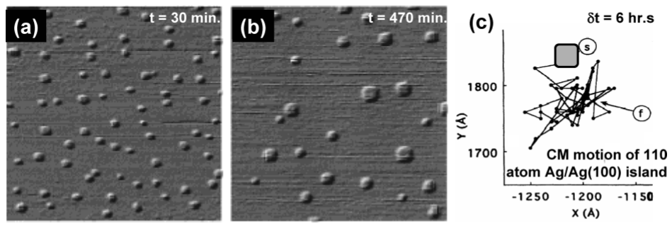
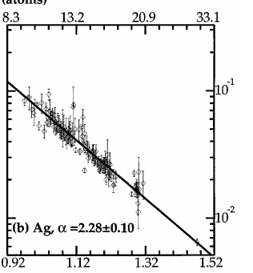
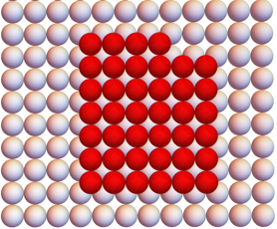
Smoluchowski Ripening of 2D Ag islands in Ag(100) surfaces
~0.5 hr
~8 hr
300 K
300 K
100 x 100 nm²
ISU group PRL (1994), PRL (1996), JCP (1999)
Review: J. Phys. Chem. C 113 (2009) 5047
$$A (in nm^{2})$$
5.78
14.54
36.51
1.56
Cluster Diffusion via edge atom hopping
Dependence of cluster diffusion coefft.
on island size, N (measured in atoms)
D_{N} ∼ N^{-1.15} for 90 < N < 400 at 300 K
Pai et al. (ORNL) PRL (1997)
versus Mean-Field (MF) Theory ⇒ D ∼ N^{-1.5}
$${10}^{−3}$$
Pai et al. PRL (1997)
$$D_{N} (nm^{2}/s)$$
2D Ag cluster on Ag(100)
$${10}^{−4}$$
0.76
5.78
1.56
1.56
Why SR versus OR? Diffusion of individual atoms at island edges is facile
on (100) surfaces. So NC diffusion mediated by edge diffusion is also facile.
$$Log_{10} A (in nm^{2})$$

Slide 15
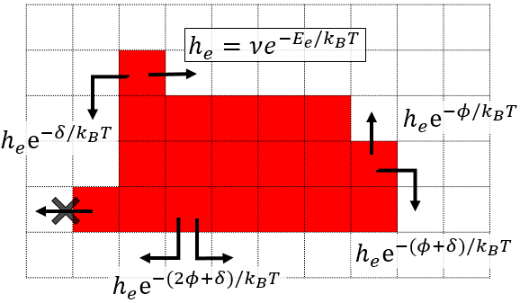
Atomistic vs continuum modeling: 2D Ag islands on Ag(100)
“TAILORED” ATOMISTIC MODEL FOR EVOLUTION VIA EDGE ATOM HOPPING
$$ν:$$
$E_{e}$:
$$δ:$$
$$φ:$$
Hopping Attempt Rate
Edge Diffusion Barrier
Corner Rounding Barrier
Strength of NN Attraction
Liu & Evans PRB (2002); Lai et al. PRB (2017)
MULLINS-TYPE CONTINUUM MODELING…
Step chemical potential: μ ∝ γ* κ
where κ = curvature ~ ∇_{s}² h, γ* = stiffness
Mass Flux: J_{PD} ∝ - σ_{PD} ∇_{s} μ + noise*
V_{n} = -∇_{s} J_{PD} ⇒ ∂h/∂t = ∇_{s} σ_{PD} ∇_{s} γ* ∇_{s}² h + conserved noise*
V_{n} = normal
velocity
Cluster size
N ∼ L² atoms
J_{PD}
s
h
L
Herring, Mullins,.. for 3D deterministic analogue; Khare & Einstein, PRL (1995), PRB (1996) – stochastic theory
⇒ shape relaxation time τ_{eq} ∼ N² ∼ L⁴; diffusion coefft. D_{N} ∼ N^{-3/2} ∼ L⁻³
E(SR) = E_{e} + φ + δ_{KES}

Slide 16
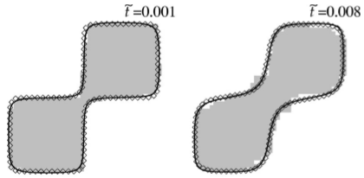
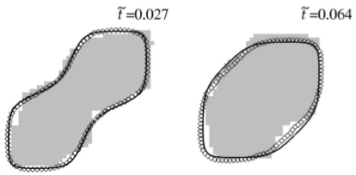
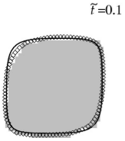
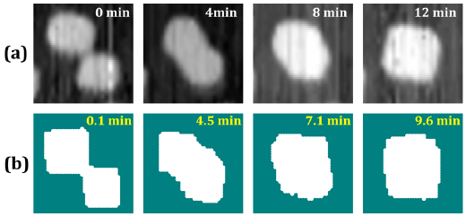
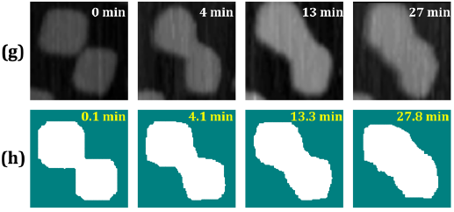
Coalescence (sintering) of pairs of 2D Ag islands on Ag(100)
Benchmark analysis with no corner rounding barrier (δ = 0): atomistic vs continuum modeling
Liu & Evans
PRB 66 (2002) 165407
•••
So for δ = 0 one has τ∼L⁴ (Mullins prediction), but for δ(Ag) ≈ 0.15 eV then τ ∼ L²⁻³ (expt & KMC)
Modeling with ab-initio thermodynamics …and kinetics !
Han, Stoldt, Thiel, Evans JPCC 120 (2016) 21617
DFT used to catalogue dominant pair, trio,.. interactions (both conventional int. determining
thermodynamics, and “unconventional” interactions determining barriers for edge diffusion)
STM
KMC
5.2 x 5.2 + 4.5 x 4.5 nm² clusters 13.0 x 13.0 + 11.5 x 11.5 nm² clusters

Slide 17
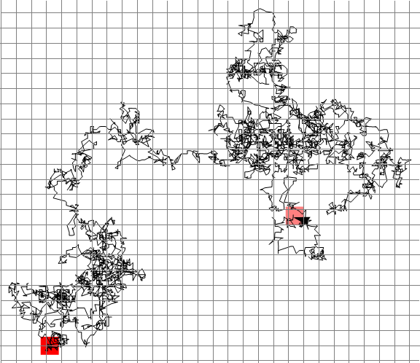
Diffusion of 2D metal clusters on metal(100) surfaces
Lai et al. J. Chem. Phys. 147 (2017) 201101; PRB 96 (2017) 235406
$$N=36$$
$$φ=0.2eV$$
$$δ=0$$
Long history of theoretical analysis
Voter, PRB 34 (1986); SPIE 821 (1986)
:
Heinonen, Kopenen, Merikoski,
Ala-Nissila, PRL 82 (1999)
:
Lai et al. JCP 147 (2017) 201101; PRB
96 (2017) 235406, JPCC 122 (2018) 11334
Motivated by expt observations of
diffusion of large clusters from mid-90’s
Wen et al. (ISU) PRL 73 (1994) 2591
Pai et al. (ORNL) PRL 79 (1997) 3210
Ye & Morgenstern PRB 85 (2012) 045417
End here
$$20a$$
$$20a$$
Start here
Example of simulated trajectory
for cluster of N = 36 atoms
Focus here on the size-dependence
of cluster diffusivity …rich behavior

Slide 18
Aside: “Perfect Cluster Sizes” with unique ground state shapes
Cluster Sizes $N= N_{P}$ $=$ $L× L or L×(L+1)$
$$N=36$$
$$N=42$$
$$6$$
$$7$$
$$6$$
$$6$$
$$7$$
$$6$$
This does not apply for $L×(L+2)$, $L×(L+3)$ etc. nor $L×L + 1$, $L×L + 2$,…
$$N=54$$
$$9$$
$$8$$
$$6$$
$$7$$

Slide 19
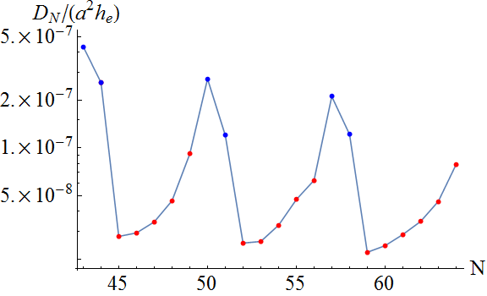
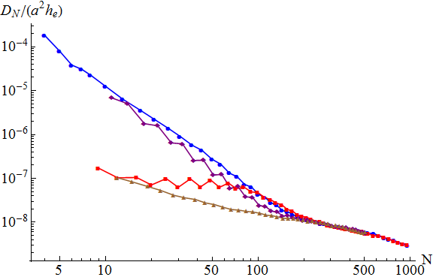
Overview of Results
A
Branches & Mechanisms
B
Size-Scaling
C
Cyclic Variation of $D_{N}$
D
Large Size Regime
E
Comparison with Experiments
K. C. Lai, D.-J. Liu, J. W. Evans
Phys. Rev. B 96 (2017) 235406.
$$N_{P}+1$$
Heinonen et al. PRL 82 (1999) noted
fast diffusion for N_{p +1} …slower for N_{p}
$$N_{P}+2$$
$$Perfect N_{P}$$
$T=300 K$ $δ=0 eV$
$φ=0.24 eV$ $L_{k}^{2}\sim 2700$
$$N_{P}+3$$
$Small$
$Sizes$
$Larger$ $Sizes$
$Moderate$ $Sizes$

Slide 20
Mechanisms of Long Range Diffusion
Facile
e.g. $N=N_{p}+1$
Nucleation Mediated
e.g. $N=N_{p}$
New Edge
New Edge
Breaks 1 Bond
Breaks 1 Bond
Breaks 1 Bond
(Before any of them moves back to the corner)
Effective Energy Barrier of Forming a New Edge $E_{eff}$
$$E_{eff}=E_{e}+φ$$
$$E_{eff}=\left(E_{e}+φ\right)+φ$$
Faster Diffusion
Slower Diffusion

Slide 21
Facile Diffusion
$$Moved 1 lattice constant$$
$$L×L+1$$
$$×$$
$$×$$
$$⋮$$
$$×$$
$$×$$
$$×$$
Wandering through configuration space of ground states
Degeneracy at ground states: $Ω_{N_{p}+1}(0)$
Cluster Size
nth excited state

Slide 22
Nucleation-Mediated Diffusion
$$Ω_{N_{p}}(0)$$
$$Moved 1 lattice constant$$
$$L×L$$
$$×$$
$$×$$
Nucleation
$$(ΔE=+φ)$$
Dissociation
of Dimer $(−φ)$
Nucleation
$$(+φ)$$
Dissociation
of Dimer $(−φ)$
$$Ω_{N_{p}}(1)$$
$$⋯$$
$$×$$
$$×$$
$$×$$
1) Being excited from configuration space $Ω_{N_{p}}(0)$
2) Wandering through configuration space $Ω_{N_{p}}(1)$
3) Dropping back to configuration space $Ω_{N_{p}}(0)$

Slide 23
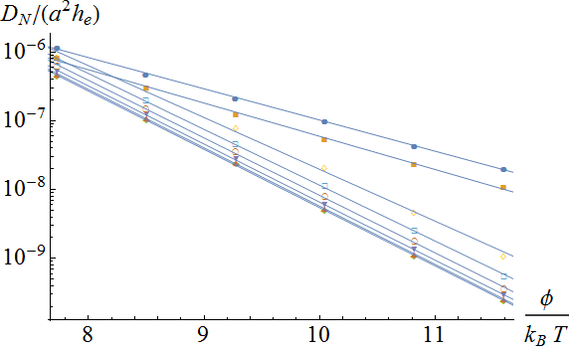
Arrhenius Plot- Varying $φ$
$$Facile \\ E_{eff}≈E_{e}+φ$$
$$D_{N}∝e^{−E_{eff}/k_{B}T}$$
$$N=57=N_{P}+1$$
$$Nucleation−mediated \\ E_{eff}≈E_{e}+2φ$$
$$N=58=N_{P}+2$$
$$N=64=N_{P}$$ $(=8×8)$
$$N=59=N_{P}+3$$
$$φ/{(k}_{B}T)$$
$$N_{p}+1, N_{p}+2:Facile$$
$$Other sizes:Nucleation−Mediated$$

Slide 24
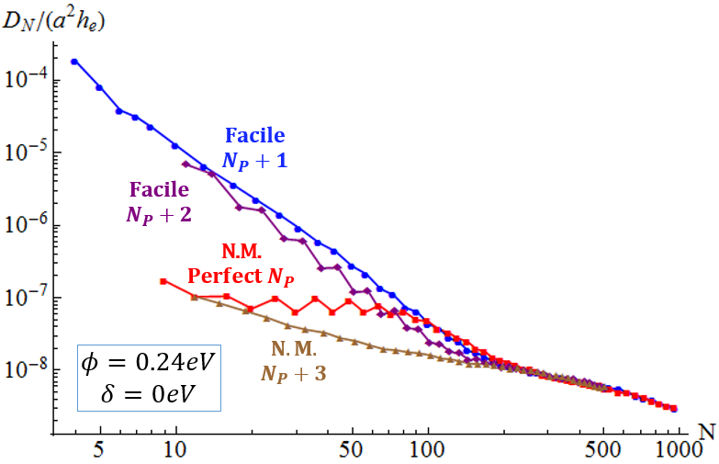
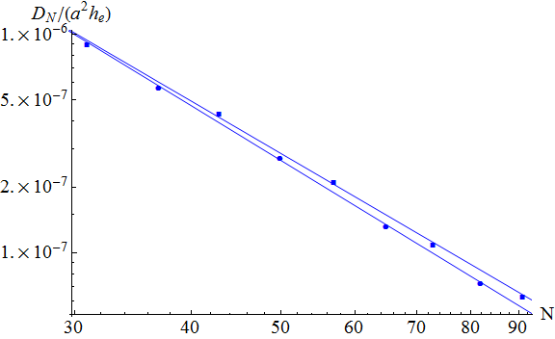
Size-Scaling Exponents of Facile Branch
$$Facile$$
$$L(L+1)+1$$
$$φ=0.24eV$$
$$δ=0eV$$
$$Facile$$
$$L^{2}+1$$
$$D_{N}\sim N^{−β}$$
 | $$Branch$$ | $$β$$
$$Facile$$ | $$L^{2}+1$$ | 2.60
 | $$L(L+1)+1$$ | 2.49
Facile Diffusion
Large size-scaling exponent $β$
(cf. MF/continuum value of β = 1.5)

Slide 25
Size-Scaling of Facile Branch, $D_{N}\sim N^{−β}$
Facile
$$Special \\ Config.$$
$$Ω_{N_{p}+1}(0)$$
$$Special \\ Config.$$
$$Moved 1 lattice constant$$
Long range diffusion requires return to special configuration after
wandering through a large phase space of ground state configurations
From the theory of random walks/first-passage times,
the average time $\left\langle t_{N}\right\rangle$ for a wandering through a large phase space and
returning to the same configuration $\left\langle t_{N}\right\rangle ∝Ω_{N}(0)$
(E. W. Montroll J. Math. Phys. 1965)
$$↓$$
$$D_{N_{P}+1}\sim 1/\left\langle t_{N}\right\rangle ∝1/Ω_{N_{p}+1}(0)$$
How to find $Ω$?

Slide 26
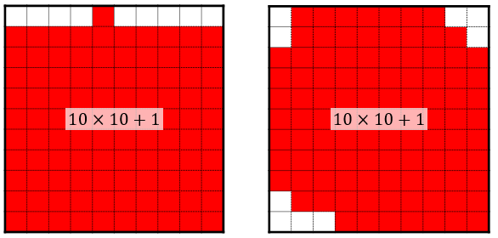
Counting Configurations:$Ω_{L^{2}+1}(0)$
Perimeter equivalent to energy of the system.
First analyze a simpler problem: determine the number of ways that
vacancies can be distributed at a single corner (creating a staircase).
This problem corresponds to analysis of integer partitions in number theory…
the different possible configurations correspond to Ferrer’s or Young’s diagrams
Solution of simpler problem leads to that of general problem (via convolution sums)

Slide 27
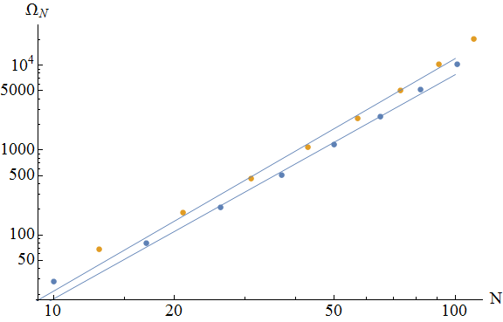
Big Size-scaling exponent $β$, $D_{N_{P}+1}\sim N^{−β}$
$$Ω_{N_{p}+1}(0)\sim N^{α}$$
$$D_{N}\sim N^{−β}$$
$$Branch$$ | $$α$$
$$L^{2}+1$$ | 2.64
$$L\left(L+1\right)+1$$ | 2.74
$$Branch$$ | $$β(0.24eV)$$
$$L^{2}+1$$ | 2.60
$$L\left(L+1\right)+1$$ | 2.49
$$Ω_{N}(0)$$
$$D_{N_{P}+1}\sim 1/Ω_{N_{p}+1}(0)$$

Slide 28
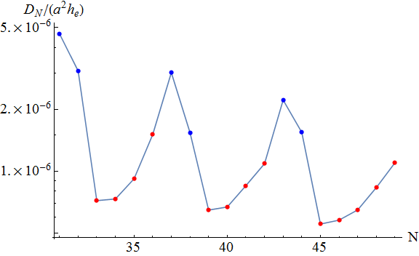
Cyclic Variation
$$φ=0.20eV$$
$$N_{P}=36=30+6$$
$$N_{P}=42=36+8$$
$$N_{P}=49=42+7$$
$$φ=0.24eV$$
$$30+3$$
$$36+3$$
$$42+3$$
$N_{P}=49$ = 42 + 7
$$N_{P}=56=49+7$$
$$N_{P}=64=56+8$$
$$42+3$$
$$49+3$$
$$56+3$$
${ N}_{P}$ are not the slowest sizes in a cycle.
$D_{N}$ increases as $N$increases from $N_{p}+3$ to next biggest $N_{p}$

Slide 29
Trends for Nucleation Mediated Mechanism
Nucleation-Mediated
$$Ω_{N}(0)$$
$$Ω_{N}(1)$$
$$Ω_{N}(0)$$
$$Moved 1 lattice constant$$
Requires excitation to diffuse
Higher chance to be excited
Higher $D_{N}$
Compare the $Ω_{N}\left(1\right)/Ω_{N}\left(0\right)$ between Nucleation Mediated cases

Slide 30
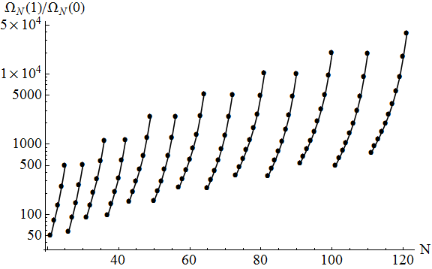
Cyclic Variation
$$φ=0.24eV$$
$$\frac{℘\left(1\right)}{℘\left(0\right)}=\frac{Ω_{N_{p}}\left(1\right)}{Ω_{N_{p}}\left(0\right)}Exp\left(\frac{−φ}{k_{B}T}\right)$$
$$N_{p}$$
$$N_{p}=121$$
$$"+3"$$
$$100$$
$$110$$
$$81$$
$$90$$
$$64$$
$$72$$
$$49$$
$$56$$
$$36$$
$$42$$
$$25$$
$$30$$
$$Easier to get excited↔more efficient for N.M.$$

Slide 31
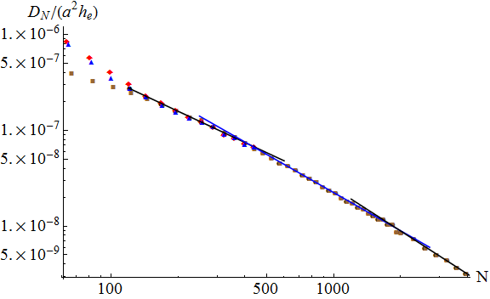
Transition to the Large Size Behavior
$$Average Kinks Separation$$
$$L_{k}=\frac{1}{2}Exp\left(\frac{1}{2}\frac{φ}{k_{B}T}\right)$$
$$φ=0.20eV$$
$$L_{k}^{2}\sim 570$$
Smaller
$$β_{eff}≈1.09$$
$$β_{eff}≈1.33$$
$$D_{N}\sim N^{−β_{eff}}$$
$$N_{P}$$
$$N_{P}+1$$
$$N_{P}+3$$
$$β_{eff}≈1.50$$
Matching mean-field model:$D_{N}\sim N^{−1.5}$

Slide 32
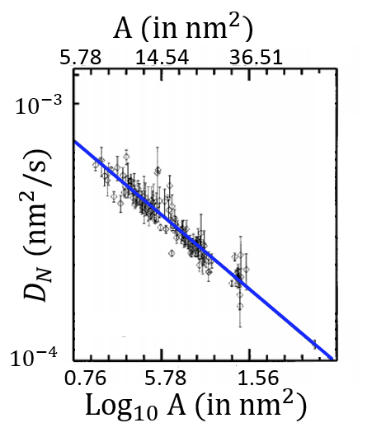
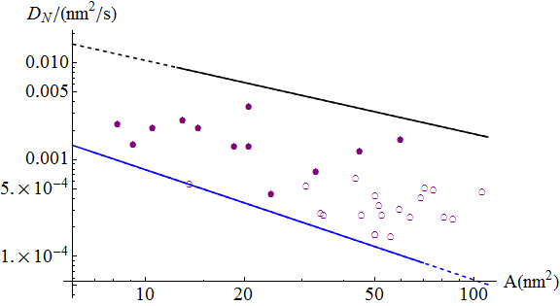
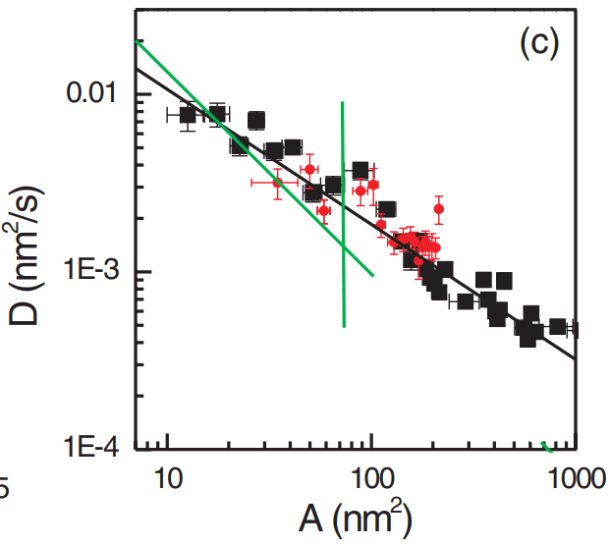
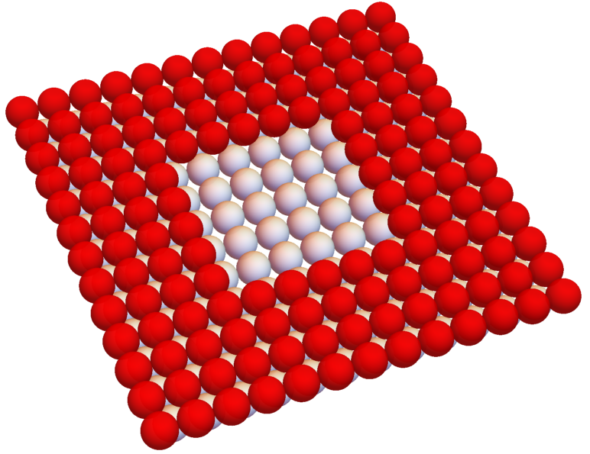
Comparison with Ag(100) Experiments
Pit
Islands
Ge, Morgenstern Phys. Rev. B 85, 045417 (2012).
Pai et al. Phys Rev Lett 79, 3210 (97).
(Oak Ridge National Lab)
ISU Experimental Data
(From Thiel group)
Experimental results not completely consistent.
Our conclusion:
Pits and islands have similar $D_{N}$
ORNL results give most precise magnitude of $D_{N}$.
Pits

Slide 33
Comparison with Ag(100) Experiments
$$φ=0.27eV for Ag, but must include non−zero kink rounding barrier >0$$
$Small δ$ ⇒ clusters diffuse faster than pits (for same N)
$δ=0.18 eV$ …clusters & pits have similar diffusivity
Large $δ$ ⇒ clusters diffuse slower than pits (for same N)
KMC Simulations
Lai et al. J. Phys. Chem. C 122, 11334 (2018)
•
•
•
Close symbol
Island
•
•
•
Open symbol
Pit
Ge, Morgenstern Phys. Rev. B 85, 045417 (2012).
ISU Experimental Data
(From Prof. Thiel’s group)
Pai et al. Phys Rev Lett 79, 3210 (97).
(From Oak Ridge National Lab)

Slide 34
SUMMARY
Alex Lai Da-Jiang Liu Yong Han Pat Thiel
NC formation or self-assembly (by diffusion-mediated nucleation & growth):
♦Realistic predictive atomistic modeling is now possible to describe individual non-
equilibrium NC shapes, but fundamental questions remain at the “ensemble level”
…exact theory for NC size distribution, CZ area distribution, JPD of NC size & CZ area
Coarsening of ensembles of NCs on surfaces:
♦ 2D islands on perfect flat crystalline surfaces (especially metal homoepitaxy)
provides “ideal examples” of Ostwald Ripening and Smoluchowski Ripening,
but also reveal “anomalous” OR for anisotropic surfaces (unequilibrated islands)
Size dependence of cluster diffusivity provides key input to Smoluchowski’s
coagulation equations to describe SR kinetics. Behavior for moderate sizes
N = 10-100 is rich with distinct branches (facile vs nucleation-mediated),
diverse size scaling, oscillations, etc. elucidated through combinatorial analysis

Slide 35
Counting Configurations:$Ω_{L^{2}+1}(0)$
Consider each corner separately:
For a corner with $m_{1}$ vacancies.
Number of possible configuration:
$$P(m_{1})$$
Found by number theory
(Integer partition, Young’s diagram)
$$4$$
$$m_{1}=4$$
$$3$$
$$2$$
$$+1$$
$$+2$$
$$2$$
$$1$$
P(4) = 5
$$+1$$
$$+1$$
$$+1$$
$$+1$$
$$+1$$

Slide 36
Counting Configurations:$Ω_{N_{P}+1}(0)$
1) Draw a inscribing rectangle corresponding to the target energy. 2) Fill the rectangle with all adatoms.
3) Consider each corner separately:
e.g.
$$P\left(3\right)$$ $possible combination$s
$$P\left(3\right) \\ possible combinations$$
$$P\left(1\right) \\ possible combinations$$
$$P\left(2\right) \\ possible combinations$$
Put four corners back together.
4)
$$Ω_{N}\left(n\right)\sim \sum_{m=m_{1}+m_{2}+m_{3}+m_{4}}{P(m_{1})P(m_{2})P(m_{3})P(m_{4})}$$

Slide 37
Pit Diffusion: Avoiding $δ$
$$Pit$$
$$⋯$$
$$Ω_{N}(0)$$
$$Ω_{N}(1)$$
$$⋯$$
$$⋯$$
$$Ω_{N}(0)$$
Some of the pathways not involving $δ$

Slide 38
Accelerated nanocluster decay: trace S + M/M(111) for M = Ag, Cu
Liu, Lee, Windus, Thiel, and Evans, Surf. Sci. 676 (2018) 2-8
Walen et al (ISU) PRB 71 (2015); Evans & Thiel, Science 330 (2010)
~70 nm
= metal atom
= sulfur atom
~50,000 atom single-layer
Ag nanocluster on Ag(111)
decays completely in ~7 min
with trace amounts of S (0.01ML)
versus ~30 hr no S at 300 K
…similar accelerated
decay of Cu islands on
Cu(111) induced by trace S
Ling, Bartelt, et al. PRL (2004)
See also: Feibelman PRL (2000)
Analysis via linearization of coupled non-linear reaction-diffusion equations for formation,
dissolution and surface diffusion of complexes (as shown below assuming Cu₂S₃ dominates)
linearize
cf. Pt catalyst degradation/sintering: mass transport by PtO₂ for Pt NP - PJF Harris, Int. Mat. Rev. 1995; Abild-Pederson et al. ACS Catal 6 (2016)

Slide 39
Metal-S complexes on (111) surfaces of Ag, Cu, Au
S on Ag(111)
S on Cu(111)
S on Au(111)
STM
DFT
DFT
DFT
STM
STM
LG modeling: long-range pair repulsions
(strain) + linear trio attractions
J Chem Phys (2013)
Russel, Da-Jiang Liu,
Y. Kim, Evans, Thiel
PRB (2015) Walen, Da-Jiang Liu, et al.
Surf Sci (2018) Liu, Lee... Thiel, Evans
JCP (2015) Walen, Da-Jiang Liu,..
cf. Reuter, Busnengo,… JPCC (2014)
S-M-S motif common for M = Ag, Cu

Slide 40
ASSEMBLY & STABILITY OF METALLIC NANOCLUSTERS
Sintering of metallic
NP with realistic surface
surface diffusion kinetics
Reshaping of cubic NP’s:
N = 244 N = 269
Diffusion of supported 3D NP’s:
Alex (King) Lai

